Slide 1
CSET301L AI and Machine Learning
Course Instructor:-
Dr. Umesh Gupta
Dr. Deepika Pantola

Slide 2
Course content : Uploaded in LMS
Course Evaluation Percentage
Mid Term Examination 15
End Term Examination 35
Assignment 10
Quiz 05
Lab Continuous Evaluation 05
Project 30

Slide 3
Labs
Labs will be in Google Colab.
For project you will get access of DGX, request basis.

Slide 4
Artificial Intelligence
not a new term …

Slide 5
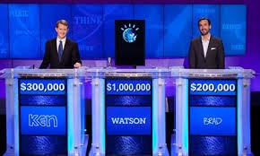
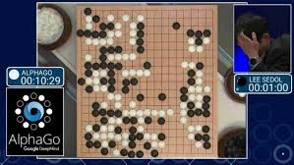
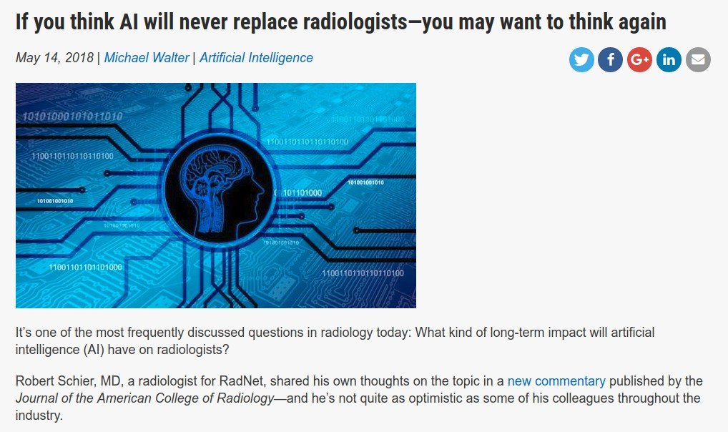
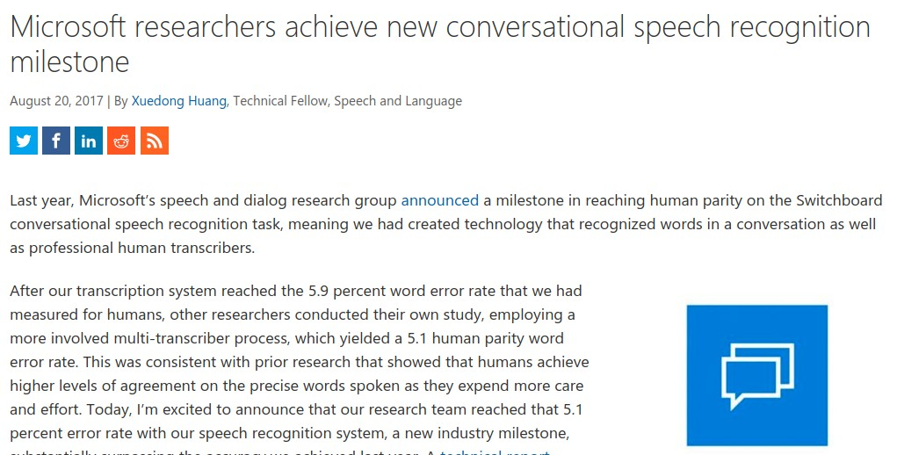
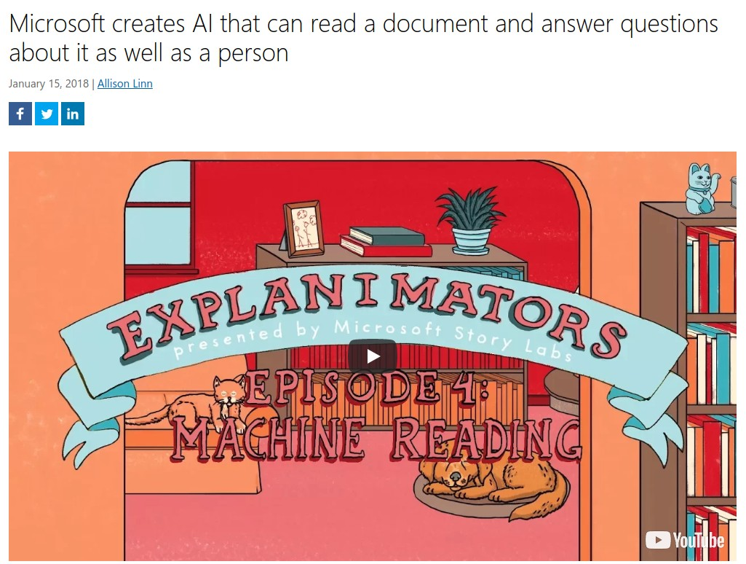
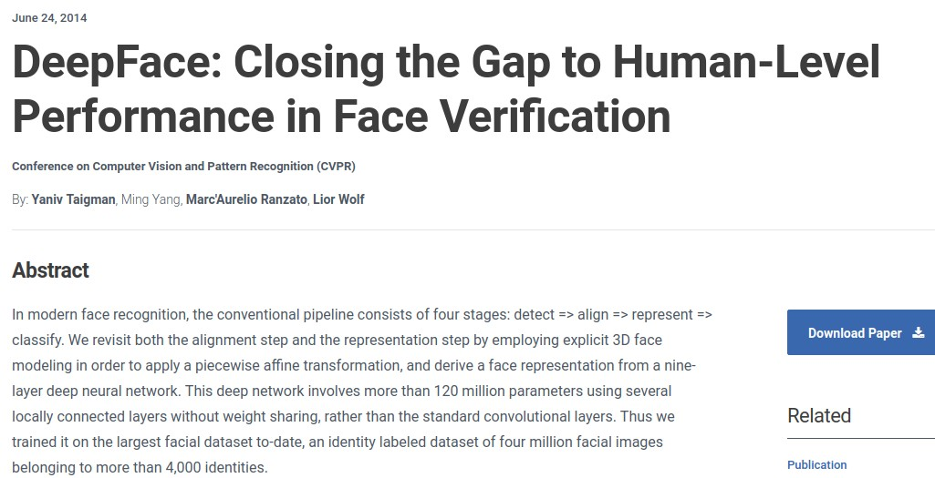
Notes:
It is hard these days to escape hearing about AI — in the news, on social media, in cafe conversations. A lot of the triumphs of superhuman performance as been in games, such as Jeopardy! (IBM Watson, 2011), Go (DeepMind’s AlphaGo, 2016), Dota 2 (OpenAI, 2019), Poker (CMU and Facebook, 2019).
On non-game tasks, we also have systems that achieve or surpass human-level performance on reading comprehension, speech recognition, face recognition, and medical imaging benchmarks.
Unlike games, however, where the game is the full problem, good performance on a benchmark does not necessarily translate to good performance on the actual task in the wild. Just because you ace an exam doesn’t necessarily mean you have perfect understanding or know how to apply that knowledge to real problems.

Slide 6
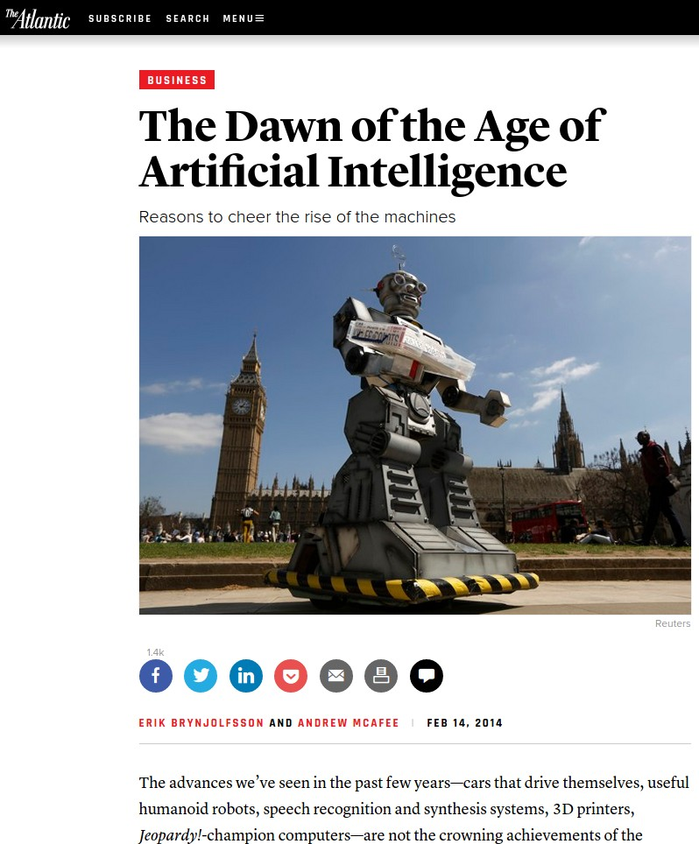
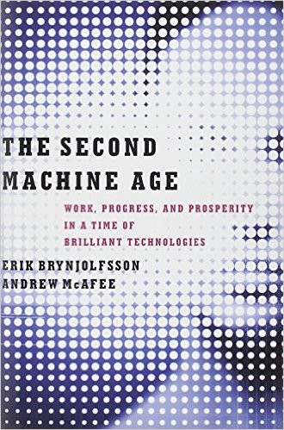
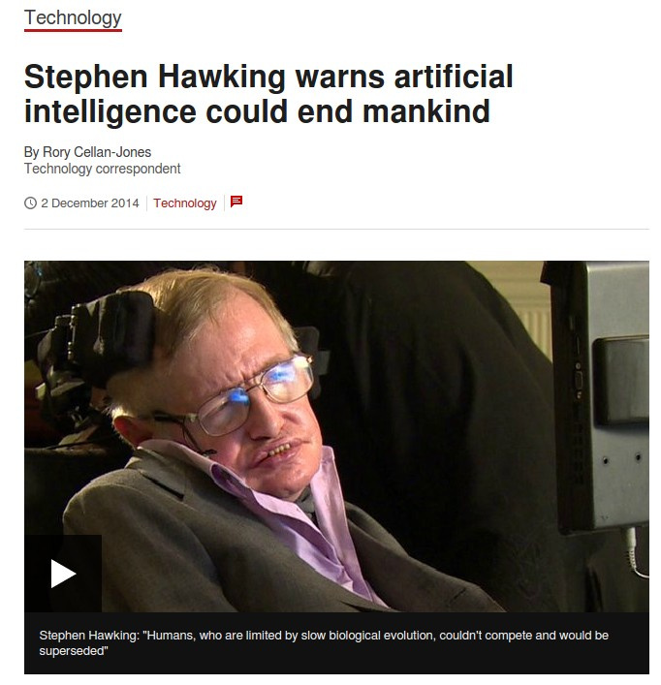
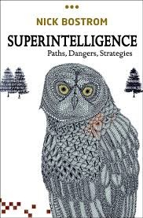
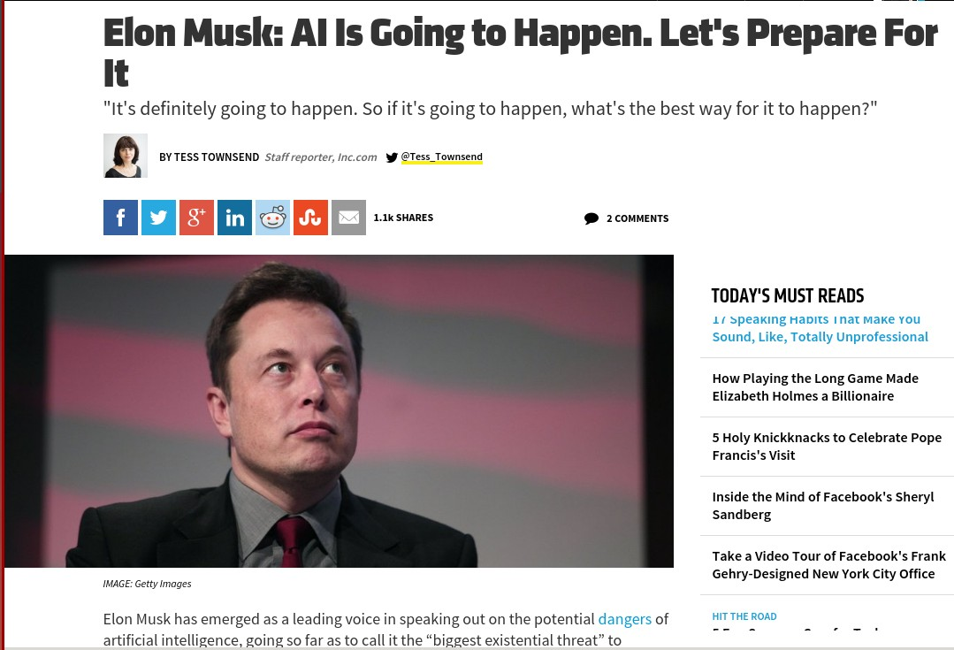
5
Notes:
We also see speculation about the future: that it will bring about sweeping societal change due to au- to mation, resulting in massive job loss, not unlike the industrial revolution, or that AI could even surpass human-level intelligence and seek to take control.
While AI is likely to be transformational, what kind of transformation the future will hold, no one knows.

Slide 7
Obvious Question
What is AI?
Programs that behave externally like humans?
Programs that operate internally as humans do?
Computational systems that behave intelligently?

Slide 8
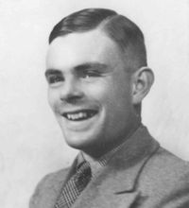
Turing Test
Human beings are intelligent
To be called intelligent, a machine must produce responses that are indistinguishable from those of a human
Alan Turing

Slide 9
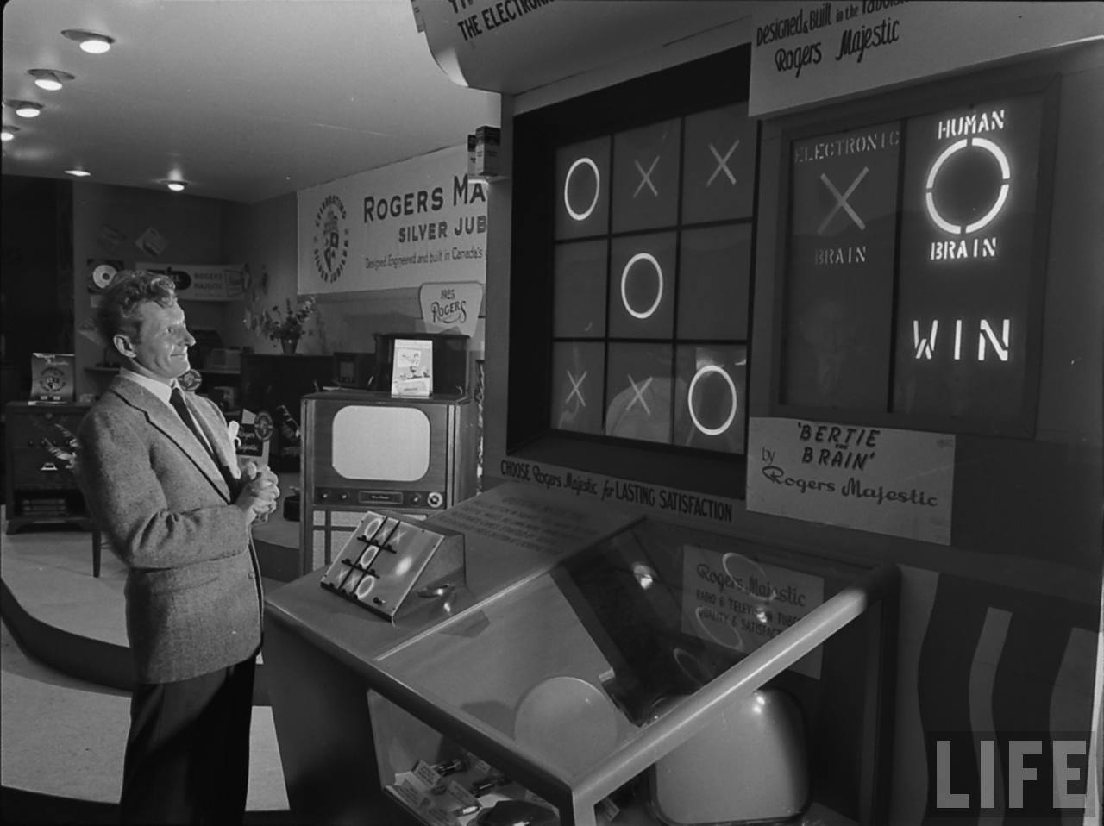
Artificial Intelligence in 1950

Slide 10

What is Machine Learning?
“Learning is any process by which a system improves performance from experience.”
- Herbert Simon
Definition by Tom Mitchell (1998):
Machine Learning is the study of algorithms that
improve their performance P
at some task T
with experience E.
A well-defined learning task is given by <P, T, E>.

Slide 11
Defining the Learning Task
Improve on task T, with respect to performance metric P, based on experience E
T: Playing checkers
P: Percentage of games won against an arbitrary opponent
E: Playing practice games against itself
T: Recognizing hand-written words
P: Percentage of words correctly classified
E: Database of human-labeled images of handwritten words
T: Driving on four-lane highways using vision sensors
P: Average distance traveled before a human-judged error
E: A sequence of images and steering commands recorded while observing a human driver.
T: Categorize email messages as spam or legitimate.
P: Percentage of email messages correctly classified.
E: Database of emails, some with human-given labels
10

Slide 12


Traditional Programming
Data Program(Features)
Output
Machine Learning
Data Output
Program(Features)
4

Slide 13
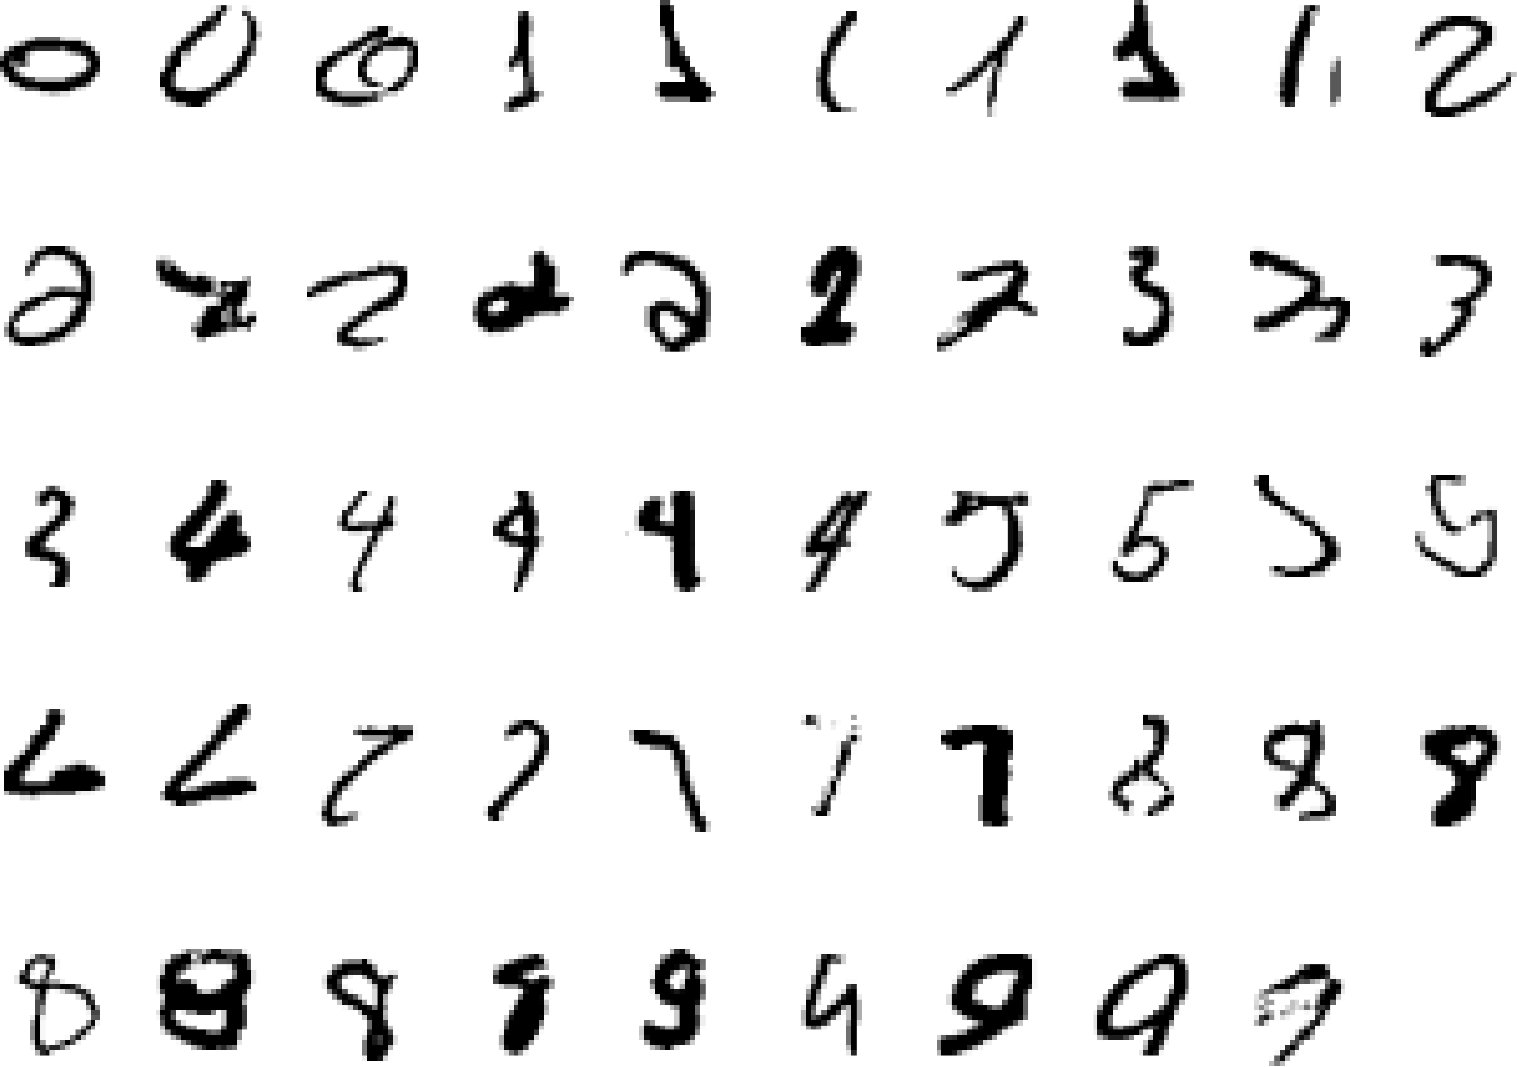
A classic example of a task that requires machine learning: It is very hard to say what makes a 2
6

Slide 14

1956

Slide 15
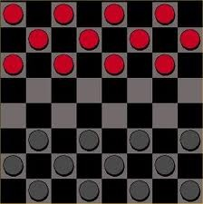

Birth of AI, early successes
Checkers (1952): Samuel’s program learned weights and played at strong amateur level
Problem solving (1955): Newell & Simon’s Logic The- orist: prove theorems in Principia Mathematica using search + heuristics; later, General Problem Solver (GPS)
10
Notes:
While they did not solve it all, there were a lot of interesting programs that were created: programs that could play checkers at a strong amateur level, programs that could prove theorems.
For one theorem Newell and Simon’s Logical Theorist actually found a proof that was more elegant than what a human came up with. They actually tried to publish a paper on it but it got rejected because it was not a new theorem; perhaps they failed to realize that the third author was a computer program.
From the beginning, people like John McCarthy sought generality, thinking of how commonsense reasoning
could be encoded in logic. Newell and Simon’s General Problem Solver promised to solve any problem (which could be suitably encoded in logic).

Slide 16
Overwhelming optimism...
Machines will be capable, within twenty years, of doing any work a man can do. —Herbert Simon
Within 10 years the problems of artificial intelligence will be substantially solved. —Marvin Minsky
I visualize a time when we will be to robots what dogs are to humans, and I’m rooting for the machines. —Claude Shannon
12

Slide 17
...underwhelming results
Example: machine translation
The spirit is willing but the flesh is weak.
(Russian)
The vodka is good but the meat is rotten.
1966: ALPAC report cut off government funding for MT, first AI winter
14
Notes:
Despite some successes, certain tasks such as machine translation were complete failures, which lead to the cutting of funding and the first AI winter.

Slide 18
Implications of early era
Problems:
Limited computation: search space grew exponentially, outpac- ing hardware (100! ≈ 10¹⁵⁷ > 10⁸⁰)
Limited information: complexity of AI problems (number of words, objects, concepts in the world)
Contributions:
Lisp, garbage collection, time-sharing (John McCarthy)
Key paradigm: separate modeling and inference
16
Notes:
What went wrong? It turns out that the real world is very complex and most AI problems require a lot of
compute and data.
The hardware at the time was simply too limited both compared to the human brain and computers available now. Also, casting problems as general logical reasoning meant that the approaches fell prey to the exponential search space, which no possible amount of compute could really fix.
Even if you had infinite compute, AI would not be solved. There are simply too many words, objects, and
concepts in the world, and this information has to be somehow encoded in the AI system.
Though AI was not solved, a few generally useful technologies came out of the effort, such as Lisp (still the world’s most advanced programming language in a sense).
One particularly powerful paradigm is the separation between what you want to compute (modeling) and how to compute it (inference).

Slide 19

Knowledge-based systems (70-80s)
Expert systems: elicit specific domain knowledge from experts in form of rules:
if [premises] then [conclusion]
CS221 / Autumn 2019 / Liang & Sadigh
18
Notes:
In the seventies and eighties, AI researchers looked to knowledge as a way to combat both the limited computation and information problems. If we could only figure out a way to encode prior knowledge in these systems, then they would have the necessary information and also have to do less compute.

Slide 20
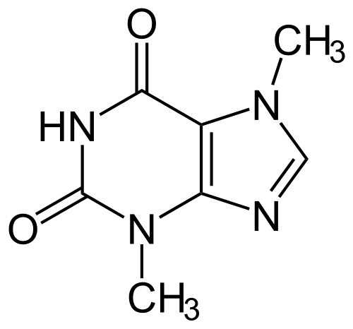

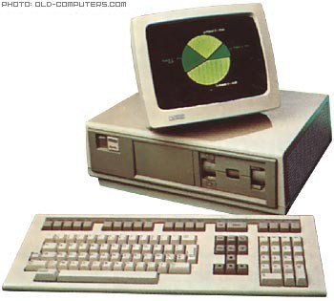
Knowledge-based systems (70-80s)
DENDRAL: infer molecular structure from mass spectrometry
MYCIN: diagnose blood infections, recommend antibiotics
XCON: convert customer orders into parts specification; save DEC $40 million a year by 1986
20
Notes:
Instead of the solve-it-all optimism from the 1950s, researchers focused on building narrow practical systems in targeted domains. These became known as expert systems.

Slide 21
Knowledge-based systems
Contributions:
First real application that impacted industry
Knowledge helped curb the exponential growth
Problems:
Knowledge is not deterministic rules, need to model uncertainty
Requires considerable manual effort to create rules, hard to main- tain
1987: Collapse of Lisp machines and second AI winter
22
Notes:
This was the first time AI had a measurable impact on industry. However, the technology ran into limitations and failed to scale up to more complex problems. Due to plenty of overpromising and underdelivering, the field collapsed again.
We know that this is not the end of the AI story, but actually it is not the beginning. There is another thread for which we need to go back to 1943

Slide 22

1943

Slide 23
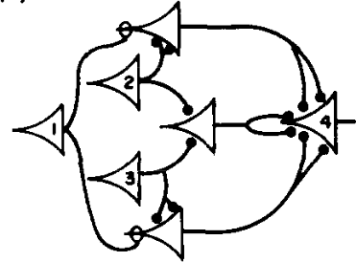

Artificial neural networks
1943: introduced artificial neural networks, connect neu- ral circuitry and logic (McCulloch/Pitts)
1969: Perceptrons book showed that linear models could not solve XOR, killed neural nets research (Min- sky/Papert)
Notes:
Much of AI’s history was dominated by the logical tradition, but there was another smaller camp, grounded in neural networks inspired by the brain.
(Artificial) neural networks were introduced by a famous paper by McCulloch and Pitts, who devised a simple mathematical model and showed how it could be be used to compute arbitrary logical functions.
Much of the early work was on understanding the mathematical properties of these networks, since com- puters were too weak to do anything interesting.
In 1969, a book was published that explored many mathematical properties of Perceptrons (linear models) and showed that they could not solve some simple problems such as XOR. Even though this result says nothing about the capabilities of deeper networks, the book is largely credited with the demise of neural networks research, and the continued rise of logical AI.

Slide 24
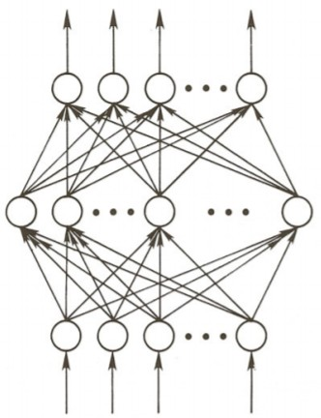
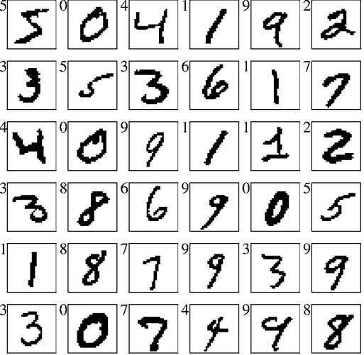
Training networks
1986: popularization of backpropagation for training multi-layer networks (Rumelhardt, Hinton, Williams)
1989: applied convolutional neural networks to recogniz- ing handwritten digits for USPS (LeCun)
27
Notes:
In the 1980s, there was a renewed interest in neural networks. Backpropagation was rediscovered and popularized as a way to actually train deep neural networks, and Yann LeCun built a system based on convolutional neural networks to recognize handwritten digits. This was one of the first successful uses of neural networks, which was then deployed by the USPS to recognize zip codes.

Slide 25
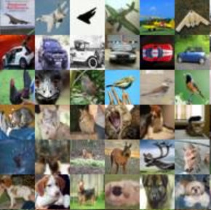
Deep learning
AlexNet (2012): huge gains in object recognition; trans- formed computer vision community overnight
AlphaGo (2016): deep reinforcement learning, world champion Lee Sedol
defeat
29
Notes:
The real break for neural networks came in the 2010s. With the rise of compute (notably GPUs) and large datasets such as ImageNet (2009), the time was ripe for the world to take note of neural networks.
AlexNet was a pivotal system that showed the promise of deep convolutional networks on ImageNet, the benchmark created by the computer vision community who was at the time still skeptical of deep learning. Many other success stories in speech recognition and machine translation followed.

Slide 26
A melting pot
Bayes rule (Bayes, 1763) from probability
Least squares regression (Gauss, 1795) from astronomy
First-order logic (Frege, 1893) from logic
Maximum likelihood (Fisher, 1922) from statistics
Artificial neural networks (McCulloch/Pitts, 1943) from neuro- science
Minimax games (von Neumann, 1944) from economics
Stochastic gradient descent (Robbins/Monro, 1951) from opti- mization
Uniform cost search (Dijkstra, 1956) from algorithms
Value iteration (Bellman, 1957) from control theory
33
Notes:
In fact, for much of the 1990s and 2000s, neural networks were not popular in the machine learning community, and the field was dominated more by techniques such as Support Vector Machines (SVMs) inspired by statistical theory.
The fuller picture is that the modern world of AI is more like New York City—it is a melting pot that has drawn from many different fields ranging from statistics, algorithms, economics, etc.
And often it is the new connections between these fields that are made and their application to important
real-world problems that makes working on AI so rewarding.

Slide 27


Two views of AI
AI agents: how can we create intelligence?
AI tools: how can we benefit society?
Notes:
There are two ways to look at AI philosophically.
The first is what one would normally associate with AI: the science and engineering of building ”intelligent” agents. The inspiration of what constitutes intelligence comes from the types of capabilities that humans possess: the ability to perceive a very complex world and make enough sense of it to be able to manipulate it.
The second views AI as a set of tools. We are simply trying to solve problems in the world, and techniques
developed by the AI community happen to be useful for that, but these problems are not ones that humans necessarily do well on natively.
However, both views boil down to many of the same day-to-day activities (e.g., collecting data and optimizing a training objective), the philosophical differences do change the way AI researchers approach and talk about their work. Moreover, the conflation of these two views can generate a lot of confusion.

Slide 28
AI agents...

Slide 29
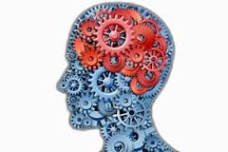
An intelligent agent
Perception
Robotics
Language
Knowledge
Reasoning
Learning
Notes:
As humans, we have to be able to perceive the world (computer vision), perform actions in it (robotics), and communicate with other agents (language).
We also have knowledge about the world (from procedural knowledge like how to ride a bike, to declarative knowledge like remembering the capital of France), and using this knowledge we can draw inferences and make decisions (reasoning).
Finally, we learn and adapt over time. We are born with none of the skills that we possess as adults, but rather the capacity to acquire them. Indeed machine learning has become the primary driver of many of the AI applications we see today.

Slide 30


Are we there yet?
Machines: narrow tasks, millions of examples
Humans: diverse tasks, very few examples
41
Notes:
The AI agents view is an inspiring quest to undercover the mysteries of intelligence and tackle the tasks that humans are good at. While there has been a lot of progress, we still have a long way to go along some dimensions: for example, the ability to learn quickly from few examples or the ability to perform commonsense reasoning.
There is still a huge gap between the regimes that humans and machines operate in. For example, AlphaGo learned from 19.6 million games, but can only do one thing: play Go. Humans on the other hand learn from a much wider set of experiences, and can do many things.

Slide 31
AI tools...
43
Notes:
The other view of AI is less about re-creating the capabilities that humans have, and more about how to benefit humans.
Even the current level of technology is already being deployed widely in practice, and many of these settings
are often not particularly human-like (targeted advertising, news or product recommendation, web search, supply chain management, etc.)

Slide 32
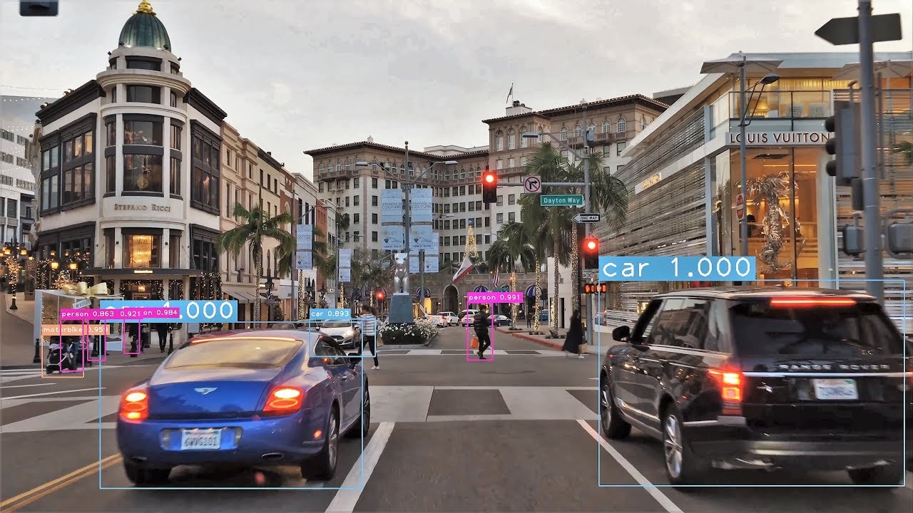


Slide 33
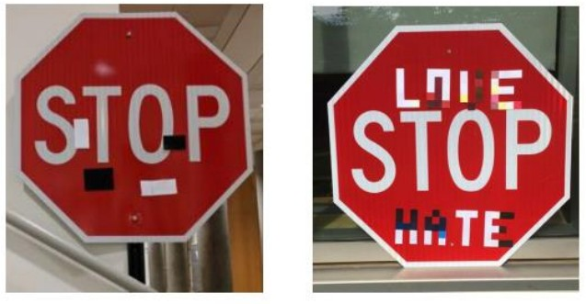
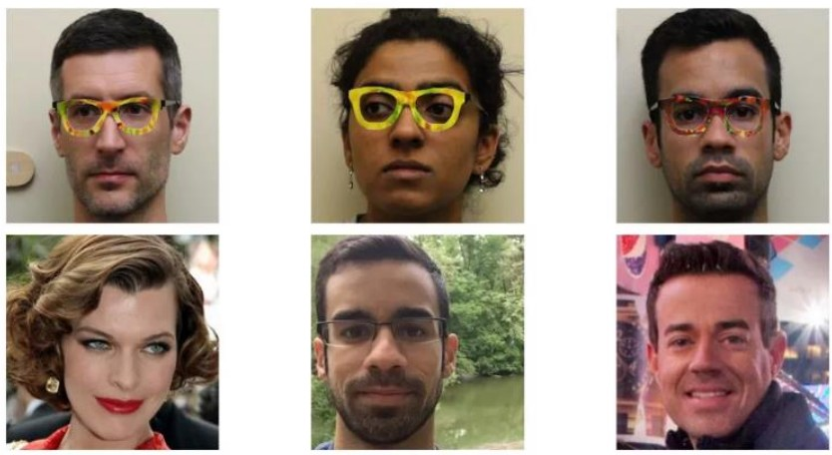
Security
[Evtimov+ 2017]
[Sharif+ 2016]
Notes:
Other applications such as self-driving cars and authentication have high-stakes, where errors could be much more damaging than getting the wrong movie recommendation. These applications present a set of security concerns.
One can generate so-called adversarial examples, where by putting stickers on a stop sign, one can trick a computer vision system into mis-classifying it as a speed limit sign. You can also purchase special glasses that fool a system into thinking that you’re a celebrity.

Slide 34
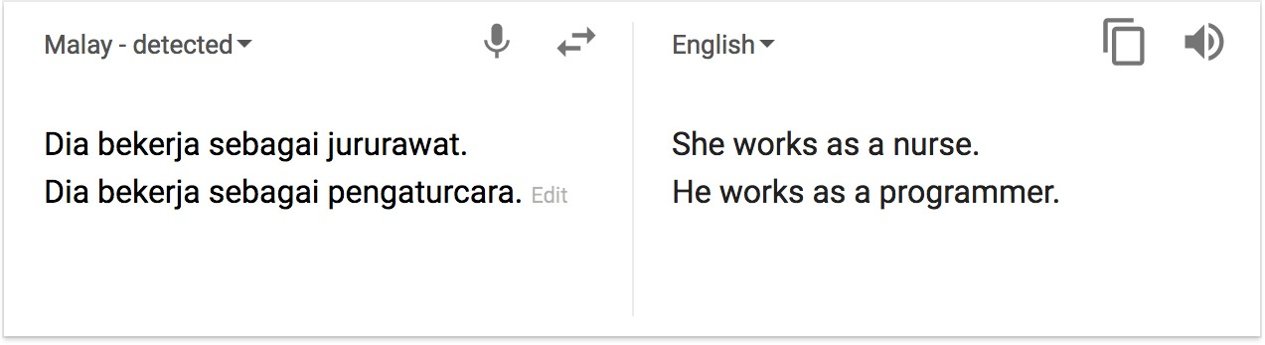
Bias in machine translation
society ⇒ data ⇒ predictions

Slide 35
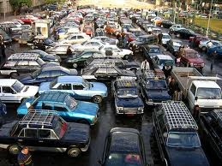
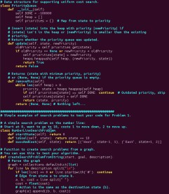
How do we solve AI tasks?
CS221 / Autumn 2019 / Liang & Sadigh
Notes:
How should we actually solve AI tasks? The real world is complicated. At the end of the day, we need to write some code (and possibly build some hardware, too). But there is a huge chasm.

Slide 36
Paradigm
Modeling
Inference
Learning
59
Notes:
In this class, we will adopt the modeling-inference-learning paradigm to help us navigate the solution space. In reality the lines are blurry, but this paradigm serves as an ideal and a useful guiding principle.

Slide 37


Paradigm: modeling
Real world
Modeling
6
7
4
5
5
5
3
1
1
Model
0
8
8
6
3
8
1
7
2
3
6
7
2
4
8
6
61
Notes:
The first pillar is modeling. Modeling takes messy real world problems and packages them into neat formal mathematical objects called models, which can be subject to rigorous analysis and can be operated on by computers. However, modeling is lossy: not all of the richness of the real world can be captured, and therefore there is an art of modeling: what does one keep versus ignore? (An exception to this are games such as Chess, Go or Sodoku, where the real world is identical to the model.)
As an example, suppose we’re trying to have an AI that can navigate through a busy city. We might formulate this as a graph where nodes represent points in the city, edges represent the roads, and the cost of an edge represents the traffic on that road.

Slide 38
Paradigm: inference
6
7
4
5
5
5
8
3
1
1
Model
0
8
6
3
8
1
7
2
3
6
7
2
4
8
6
Inference
6
7
4
5
8
5
5
3
1
Predictions
0
6
3
8
8
1
1
7
2
3
6
7
2
4
8
6
63
Notes:
The second pillar is inference. Given a model, the task of inference is to answer questions with respect to the model. For example, given the model of the city, one could ask questions such as: what is the shortest path? what is the cheapest path?
The focus of inference is usually on efficient algorithms that can answer these questions. For some models, computational complexity can be a concern (games such as Go), and usually approximations are needed.

Slide 39
Paradigm: learning
?
?
?
?
?
?
?
?
?
?
Model without parameters
?
?
?
?
?
?
?
?
?
?
?
?
?
?
?
+data
Learning
6
7
4
5
5
5
3
1
1
Model with parameters
0
8
8
6
3
8
1
7
2
3
6
7
2
4
8
6
65
Notes:
But where does the model come from? Remember that the real world is rich, so if the model is to be faithful, the model has to be rich as well. But we can’t possibly write down such a rich model manually.
The idea behind (machine) learning is to instead get it from data. Instead of constructing a model, one constructs a skeleton of a model (more precisely, a model family), which is a model without parameters. And then if we have the right type of data, we can run a machine learning algorithm to tune the parameters of the model.
Note that learning here is not tied to a particular approach (e.g., neural networks), but more of a philosophy.
This general paradigm will allow us to bridge the gap between logic-based AI and statistical AI.

Slide 40

Machine learning
Data
Model
The main driver of recent successes in AI
Move from ”code” to ”data” to manage the information complex- ity
Requires a leap of faith: generalization
69
Notes:
Supporting all of these models is machine learning, which has been arguably the most crucial ingredient powering recent successes in AI. From a systems engineering perspective, machine learning allows us to shift the information complexity of the model from code to data, which is much easier to obtain (either naturally occurring or via crowdsourcing).
The main conceptually magical part of learning is that if done properly, the trained model will be able to produce good predictions beyond the set of training examples. This leap of faith is called generalization, and is, explicitly or implicitly, at the heart of any machine learning algorithm. This can even be formalized using tools from probability and statistical learning theory.

Slide 41
Reflex
”Low-level intelligence”
”High-level intelligence”
AI and Machine learning

Slide 42
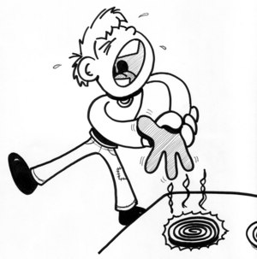
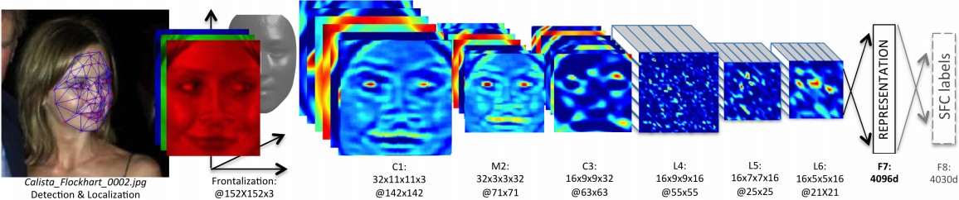
Reflex-based models
Examples: linear classifiers, deep neural networks
Most common models in machine learning
Fully feed-forward (no backtracking)
73
Notes:
A reflex-based model simply performs a fixed sequence of computations on a given input. Examples include most models found in machine learning, from simple linear classifiers to deep neural networks. The main characteristic of reflex-based models is that their computations are feed-forward; one doesn’t backtrack and consider alternative computations. Inference is trivial in these models because it is just running the fixed computations, which makes these models appealing.

Slide 43
Search problems
Markov decision processes Adversarial games
Reflex
States
”Low-level intelligence”
”High-level intelligence”
AI and Machine learning
75

Slide 44
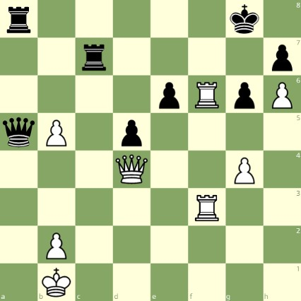
State-based models
White to move

Slide 45
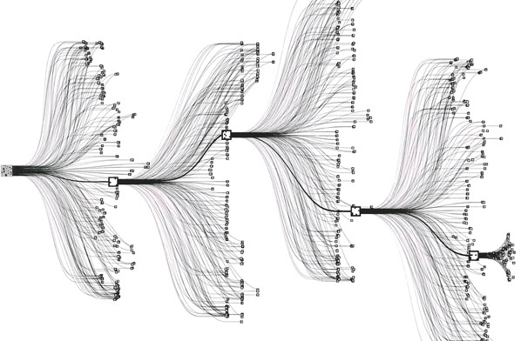
State-based models
Applications:
Games: Chess, Go, Pac-Man, Starcraft, etc.
Robotics: motion planning
Natural language generation: machine translation, image caption- ing
Notes:
Reflex-based models are too simple for tasks that require more forethought (e.g., in playing chess or planning a big trip). State-based models overcome this limitation.
The key idea is, at a high-level, to model the state of a world and transitions between states which are triggered by actions. Concretely, one can think of states as nodes in a graph and transitions as edges. This reduction is useful because we understand graphs well and have a lot of efficient algorithms for operating on graphs.

Slide 46
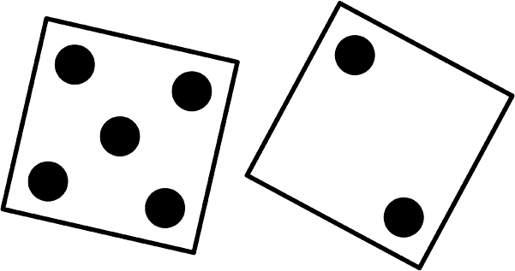

State-based models
Search problems: you control everything
Markov decision processes: against nature (e.g., Blackjack)
Adversarial games: against opponent (e.g., chess)
79
Notes:
Search problems are adequate models when you are operating in an environment that has no uncertainty. However, in many realistic settings, there are other forces at play.
Markov decision processes handle tasks with an element of chance (e.g., Blackjack), where the distri- bution of randomness is known (reinforcement learning can be employed if it is not).
Adversarial games, as the name suggests, handle tasks where there is an opponent who is working against you (e.g., chess).

Slide 47
Search problems
Markov decision processes
Constraint satisfaction problems
Adversarial games
Bayesian networks
Reflex
States
Variables
”Low-level intelligence”
”High-level intelligence”
AI and Machine learning

Slide 48
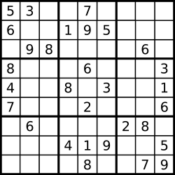
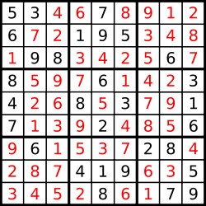
Sudoku
Goal: put digits in blank squares so each row, column, and 3x3 sub-block has digits 1–9
Note: order of filling squares doesn’t matter in the evaluation criteria!
Notes:
In state-based models, solutions are procedural: they specify step by step instructions on how to go from A to B. In many applications, the order in which things are done isn’t important

Slide 49
Variable-based models
Constraint scheduling)
satisfaction problems: hard constraints
(e.g.,
Sudoku,
X₁
X₂
X₃ X₄
Bayesian networks: soft dependencies (e.g., tracking cars from sensors)
H₁ H₂ H₃ H₄ H₅
E₁
E₂
E₃
E₄
E₅
85
Notes:
Constraint satisfaction problems are variable-based models where we only have hard constraints. For example, in scheduling, we can’t have two people in the same place at the same time.
Bayesian networks are variable-based models where variables are random variables which are dependent on each other. For example, the true location of an airplane H_{t} and its radar reading E_{t} are related, as are the location H_{t} and the location at the last time step H_{t−1}. The exact dependency structure is given by the graph structure and it formally defines a joint probability distribution over all of the variables. This topic is studied thoroughly in probabilistic graphical models

Slide 50
Search problems
Markov decision processes
Constraint satisfaction problems
Adversarial games
Bayesian networks
Reflex
States
Variables
Logic
”Low-level intelligence”
”High-level intelligence”
AI and Machine learning

Slide 51


Motivation: virtual assistant
Tell information
Ask questions
Use natural language!
[demo]
Need to:
Digest heterogenous information
Reason deeply with that information
Notes:
It is interesting that historically, logic was one of the first things that AI researchers started with in the 1950s. While logical approaches were in a way quite sophisticated, they did not work well on complex real-world tasks with noise and uncertainty. On the other hand, methods based on probability and machine learning naturally handle noise and uncertainty, which is why they presently dominate the AI landscape. However, they are yet to be applied successfully to tasks that require really sophisticated reasoning.
In this course, we will appreciate the two as not contradictory, but simply tackling different aspects of
AI — in fact, in our course plan, logic is a class of models which can be supported by machine learning. An active area of research is to combine the richness of logic with the robustness and agility of machine learning.
One motivation for logic is a virtual assistant. At an abstract level, one fundamental thing a good personal assistant should be able to do is to take in information from people and be able to answer questions that require drawing inferences from these facts.
In some sense, telling the system information is like machine learning, but it feels like a very different form of learning than seeing 10M images and their labels or 10M sentences and their translations. The type of information we get here is both more heterogenous, more abstract, and the expectation is that we process it more deeply (we don’t want to tell our personal assistant 100 times that we prefer morning meetings).
And how do we interact with our personal assistants? Let’s use natural language, the very tool that was built for communication!

Slide 52
Optimization
Discrete optimization: find the best discrete object
min Cost(p)
p∈Paths
Algorithmic tool: dynamic programming
Continuous optimization: find the best vector of real numbers
min TrainingError(w)
w∈R^{d}
Algorithmic tool: gradient descent

Slide 53
Types of Learning
21

Slide 54
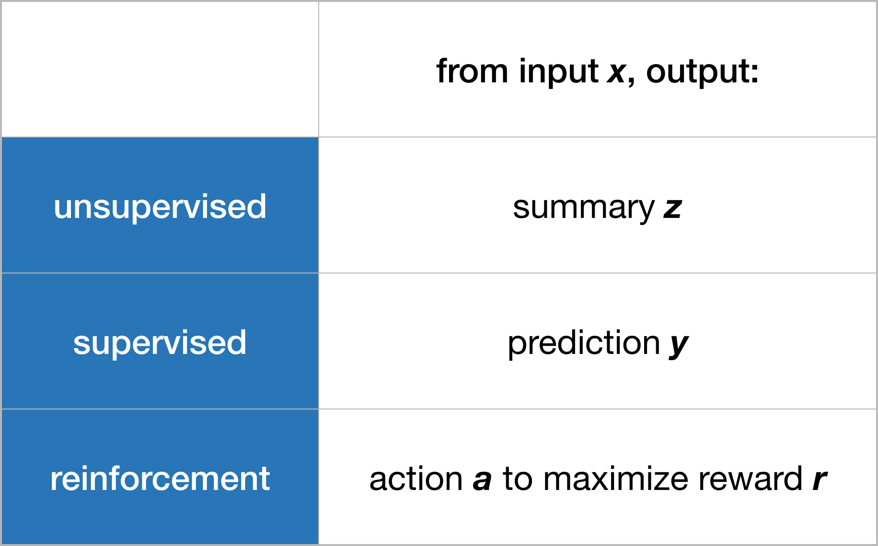
Types of Learning
22
From Wiggins, Recht

Slide 55

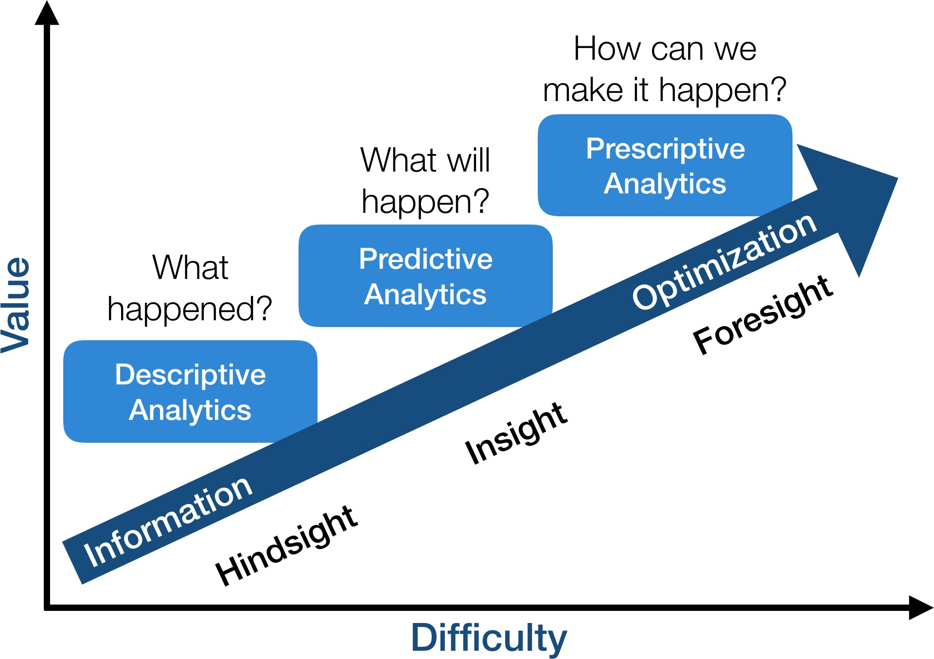


Types of Learning
Reinforcement Learning
Supervised Learning
Unsupervised Learning
23
From Gartner, Recht

Slide 56














Unsupervised Learning
Given x₁, x₂, ..., x_{n} (without labels)
Output structure in the x’s
– E.g., clustering
24

Slide 57












Unsupervised Learning
Organize computing clusters
Social network analysis
Market segmentation
Slide credit: Andrew Ng
Image credit: NASA/JPL-Caltech/E. Churchwell (Univ. of Wisconsin, Madison)
Astronomical data analysis
25

Slide 58






Supervised Learning: Regression
Given (x₁, y₁), (x₂, y₂), ..., (x_{n}, y_{n})
Learn a function f(x) to predict y given x
– y is real-valued == regression
9
8
7
6
5
4
3
2
1
0
1970 1980
September Arctic Sea Ice Extent (1,000,000 sq km)
1990 2000
2010
2020
Year
Data from G. Witt. Journal of Statistics Education, Volume 21, Number 1 (2013)
26

Slide 59










Supervised Learning: Classification
Given (x₁, y₁), (x₂, y₂), ..., (x_{n}, y_{n})
Learn a function f(x) to predict y given x
– y is categorical == classification
Breast Cancer (Malignant / Benign)
1(Malignant)
0(Benign)
Tumor Size
Predict Benign Predict Malignant
Tumor Size
27
Based on example by Andrew Ng

Slide 60









Supervised Learning
x can be multi-dimensional
– Each dimension corresponds to an attribute
Clump Thickness
Uniformity of Cell Size
Uniformity of Cell Shape
…
Age
Tumor Size
28
Based on example by Andrew Ng

Slide 61
Reinforcement Learning
Given a sequence of states and actions with (delayed) rewards, output a policy
Policy is a mapping from states → actions that tells you what to do in a given state
Examples:
Credit assignment problem
Game playing
Robot in a maze
Balance a pole on your hand
29

Slide 62
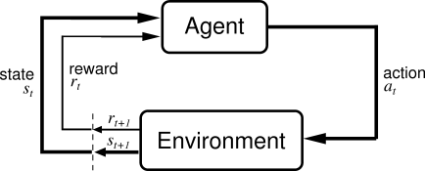
The Agent-Environment Interface
30

